Slide 1
United States Department of Agriculture
National Agricultural Statistics Service
May Crop Report
June Acreage
July Crop Report
July 10 Crop Progress and Condition
Nicholas Streff
USDA NASS
July 2023

Slide 2
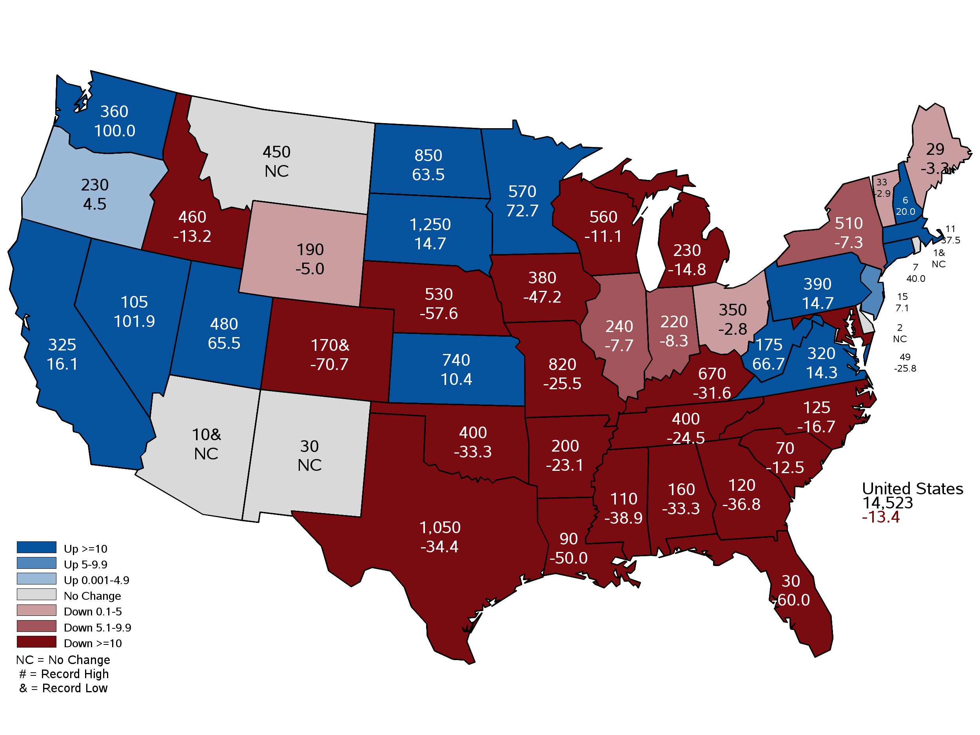
May 2023 Hay Stocks
Thousand Tons and Percent Change from Previous Year
May 12, 2023
Notes:
Hay Stocks
2023 @ 530,000 tons
Lowest since 2001 @ 493,000 tons
10 yr avg Stocks= 1,113,500
2022 Production: 4.3 million tons down 31% from previous year.
10 yr average 5.9 million tons.
Year Stocks in Nebraska
2023 530,000
2022 1,250,000
2021 1,000,000
2020 1,380,000
2019 1,070,000
2018 700,000
2017 1,275,000
2016 1,450,000
2015 1,250,000
2014 1,150,000
2013 610,000
2012 1,070,000
2011 1,335,000
2010 1,000,000

Slide 3
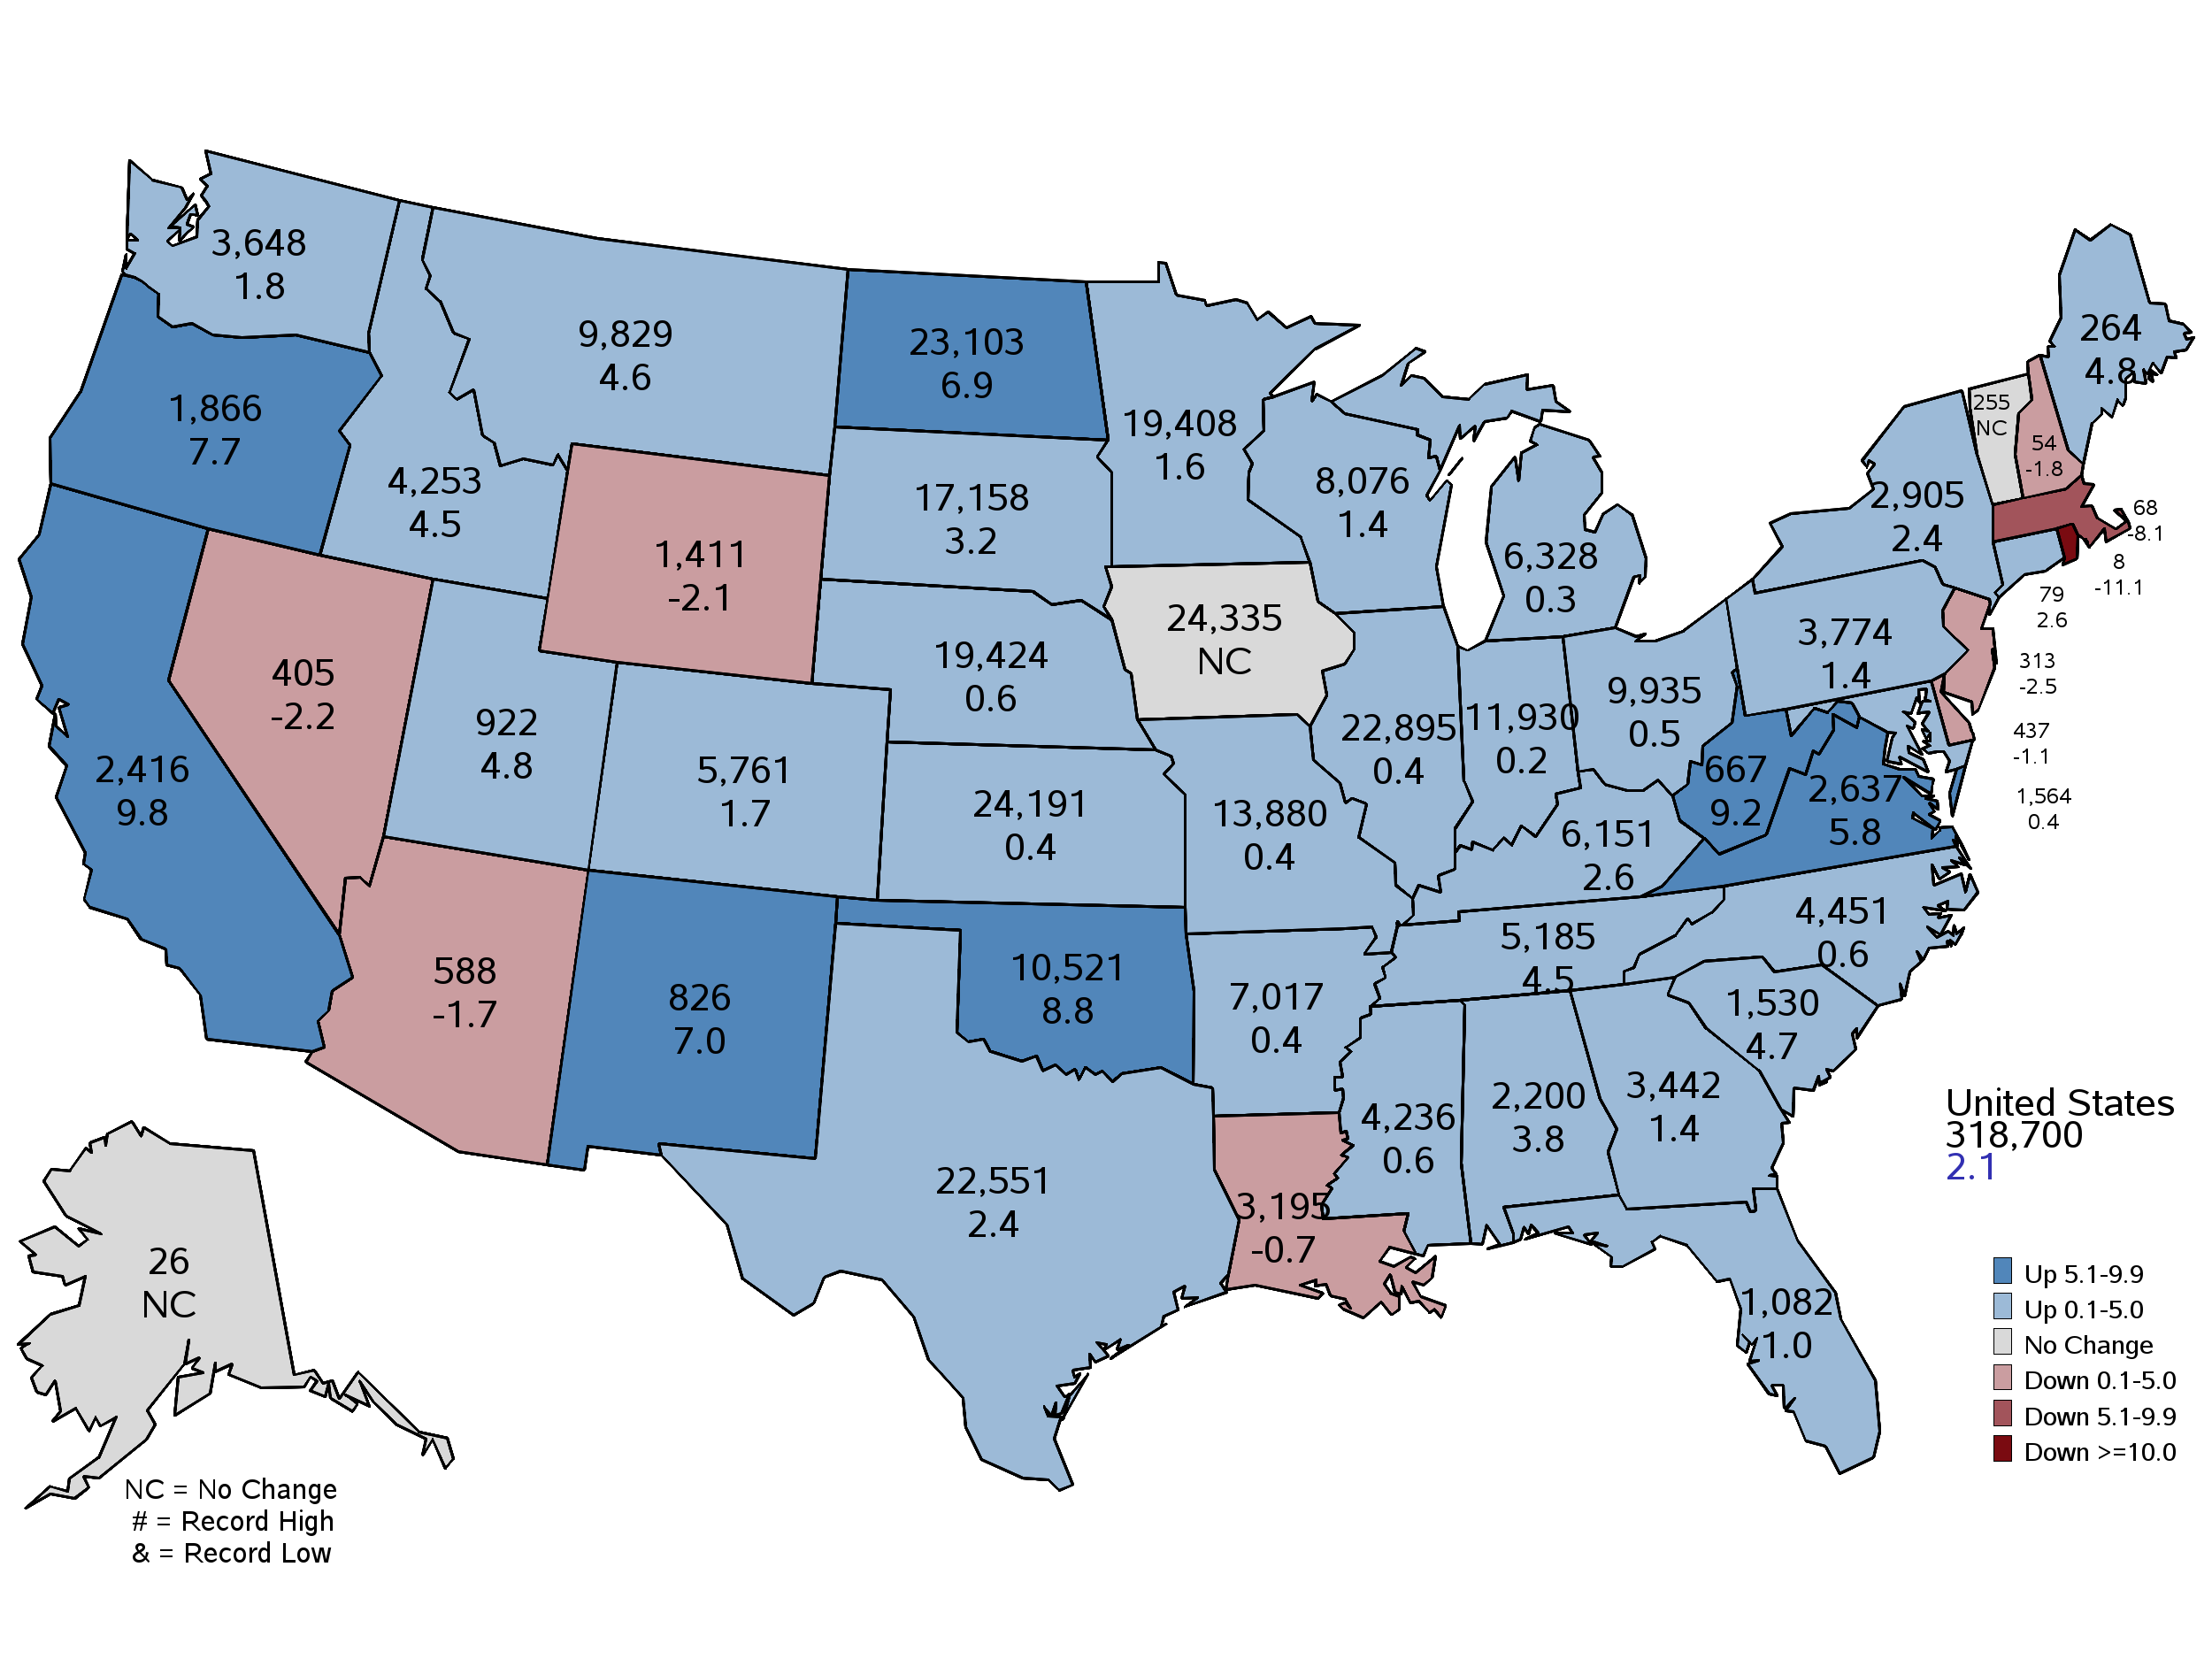
2023 Principal Crops Planted
Thousand Acres and Percent Change from Previous Year
June 30, 2023
Notes:
Principal Crops
Highest since:
ID – 2014
IL – 2018
KY – 2015
MS – 2015
MO – 2014
NY – 2016
NC – 2018
OK – 2014
SC – 2017
SD – 2018
TN - 2013

Slide 4
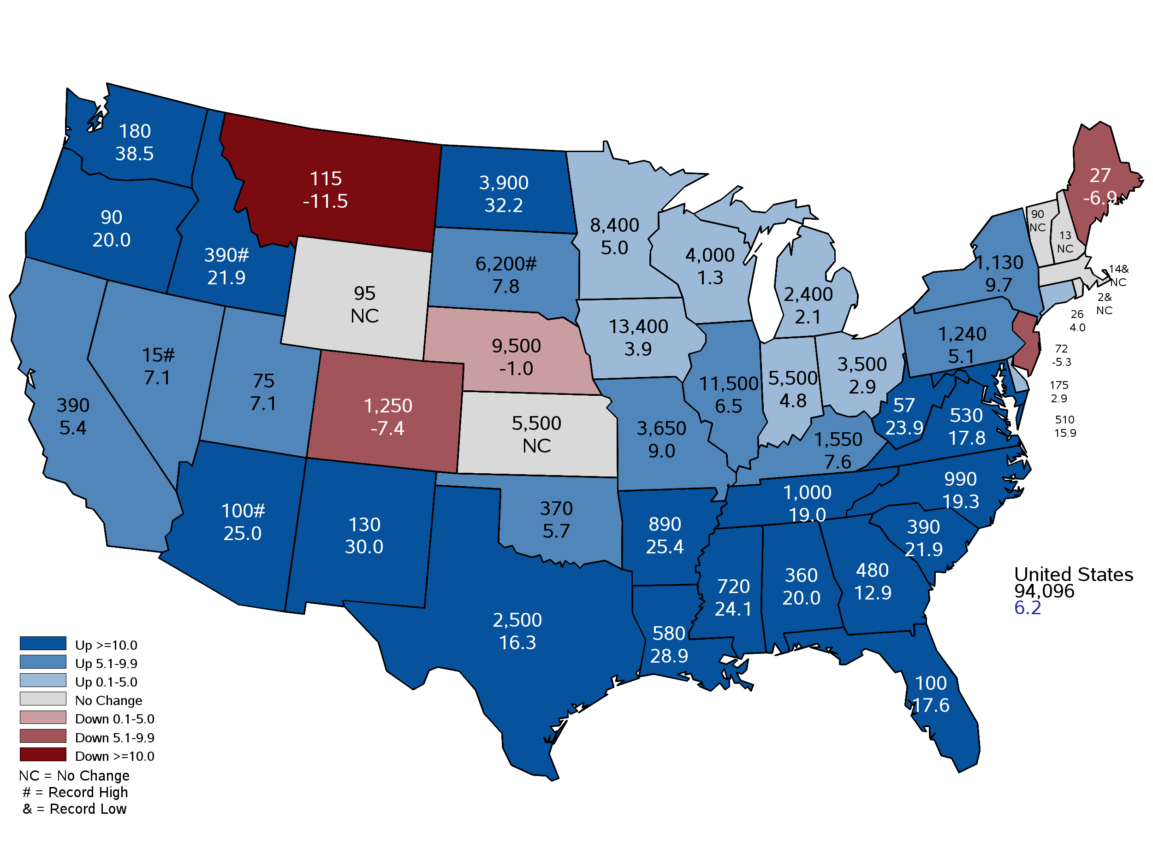
2023 Corn Planted Acreage
Thousand Acres and Percent Change from Previous Year
June 30, 2023
Notes:
Corn Planted
Nebraska 9.5 million acres planted down from 9.6 million last year.
Based on survey responses from farmers and ranchers.
NE Sample Size 3,200 and about 1,200 area records
Record high planted ac in AZ, ID, NV, & SD (tied with ’13)
Record low in MA & RI
Other noteworthy landmarks
AL highest ac since ’82
AR highest ac since ’52
WV highest ac since ’98
IL, IN, MI, & WI all highest ac since ‘16

Slide 5
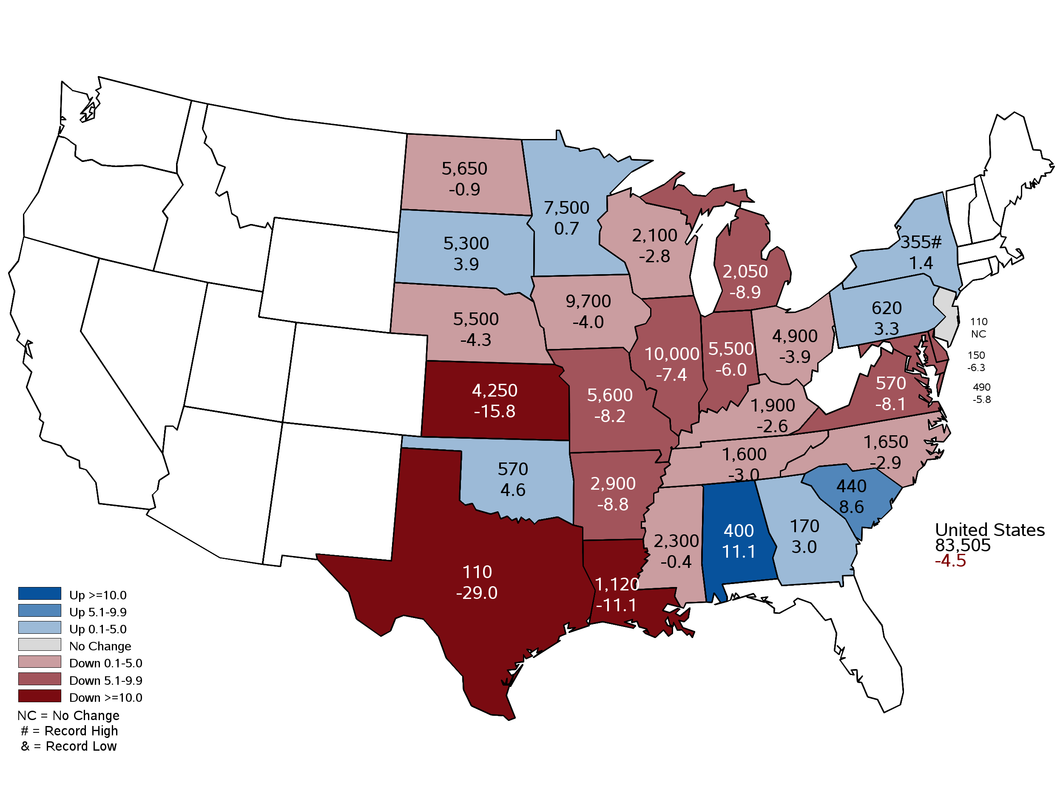
2023 Soybean Planted Acreage
Thousand Acres and Percent Change from Previous Year
June 30, 2023
Notes:
Soybeans Planted
Nebraska at 5.5 million acres, down from 5.75 million acres last year (250,000).
CRP acres are up over 300,000 acres this year. Wheat is up 170.

Slide 6
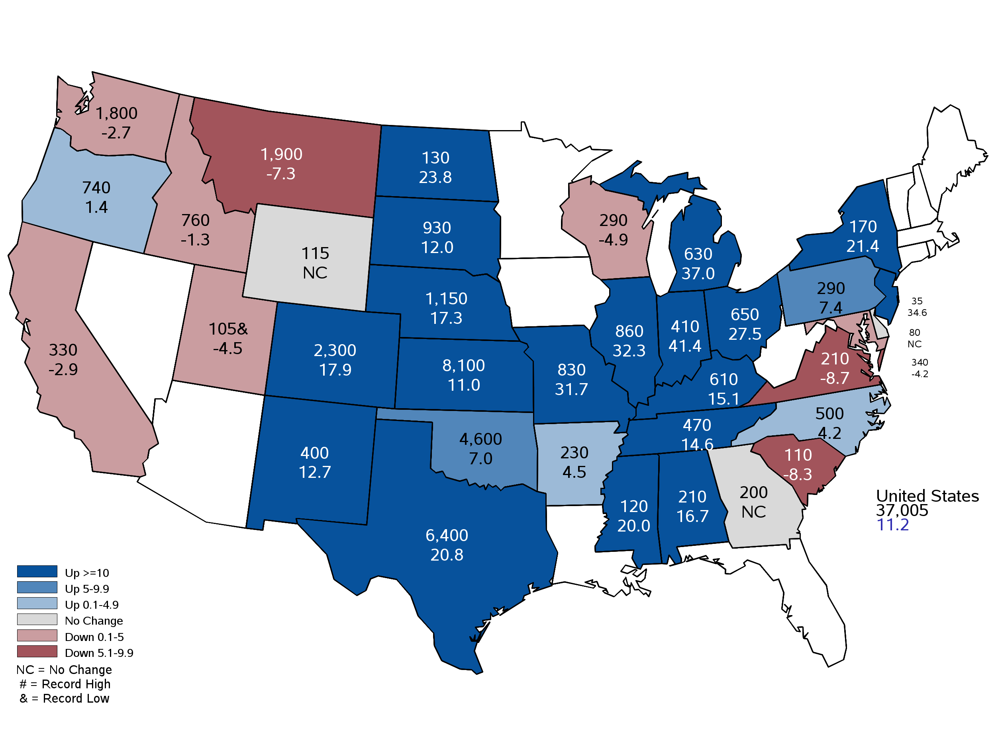
2023 Winter Wheat Planted Acres
Thousand Acres and Percent Change from Previous Year
June 30, 2023
Notes:
Winter Wheat Planted Acres
Nebraska winter wheat @ 1.15 million acres up from 980,000 last year.

Slide 7
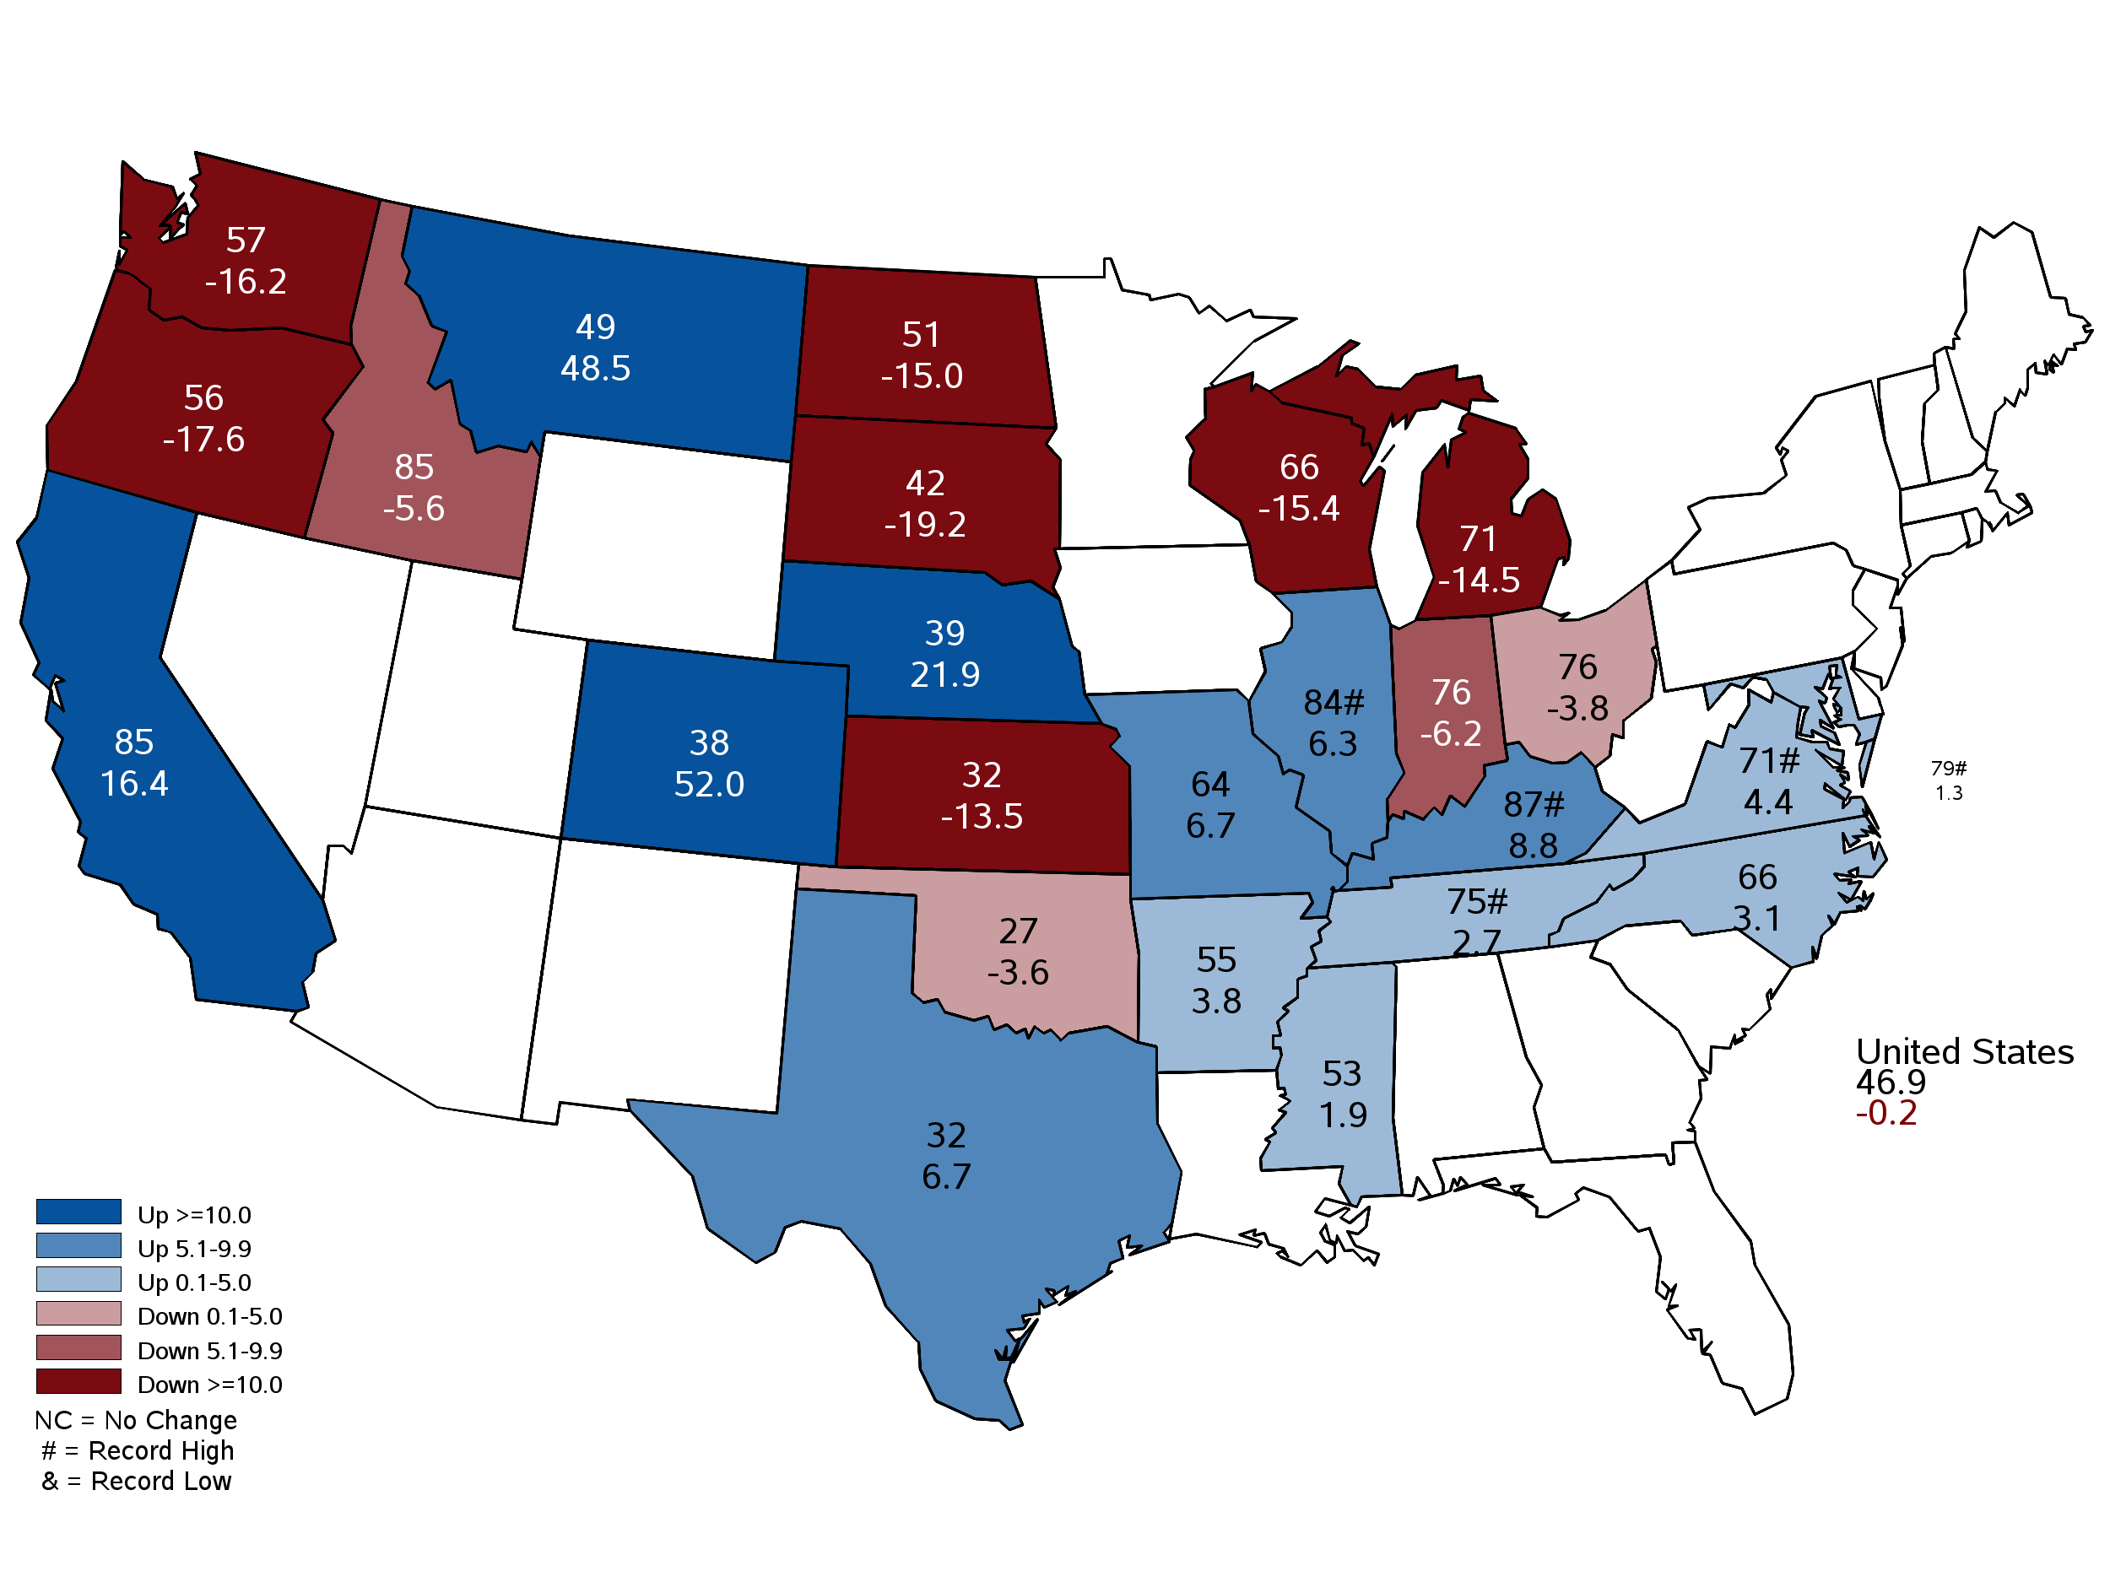
July 2023 Winter Wheat Yield
Bushels and Percent Change from Previous Year
July 12, 2023
Notes:
Winter Wheat Yield
Nebraska winter wheat yield is forecast at 39 bushels per acre, up 7 bushels from last year.
Production is forecast @ 33.2 million bushels, up 26% from last year.

Slide 8
Crop Progress and Condition July 10
 | Very Poor | Poor | Fair | Good | Excellent
Corn | 5% | 10% | 23% | 41% | 21%
Soybeans | 7% | 12% | 26% | 41% | 14%
Pasture and Range | 3% | 11% | 34% | 44% | 8%
 | Very Short | Short | Adequate | Surplus
Topsoil Moisture | 14% | 26% | 57% | 3%
Subsoil Moisture | 23% | 38% | 38% | 1%
7-10-23
Notes:
Corn is 62% good to excellent
Soybeans 55% good to excellent
Pasture and Range 52% good to excellent
Moisture
Topsoil is 60% Adequate to Surplus
Subsoil is 39% Adequate to Surplus

Slide 9
Crop Progress and Condition July 10
7-10-23
Notes:
Corn 78 percent good to excellent

Slide 10
7-10-23

Slide 11
Crop Progress and Condition July 10
7-10-23
Notes:
Soybean 81 percent good to excellent

Slide 12
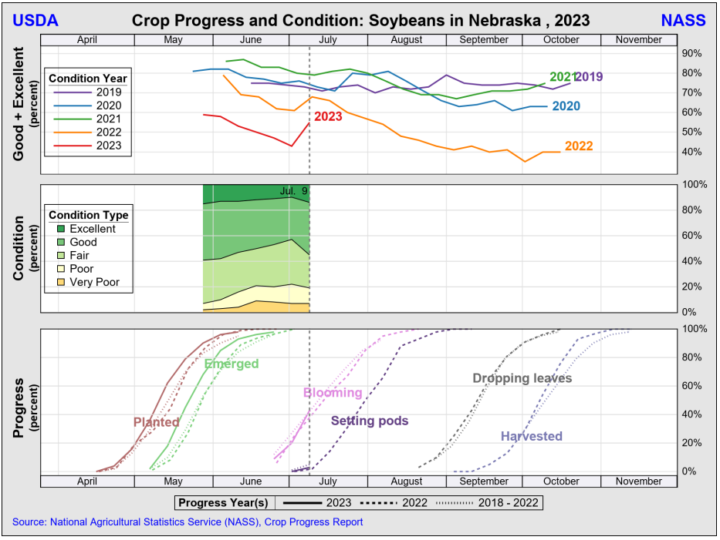
7-10-23

Slide 13
Crop Progress and Condition July 10
7-10-23
Notes:
Pasture: 29 % good to excellent

Slide 14
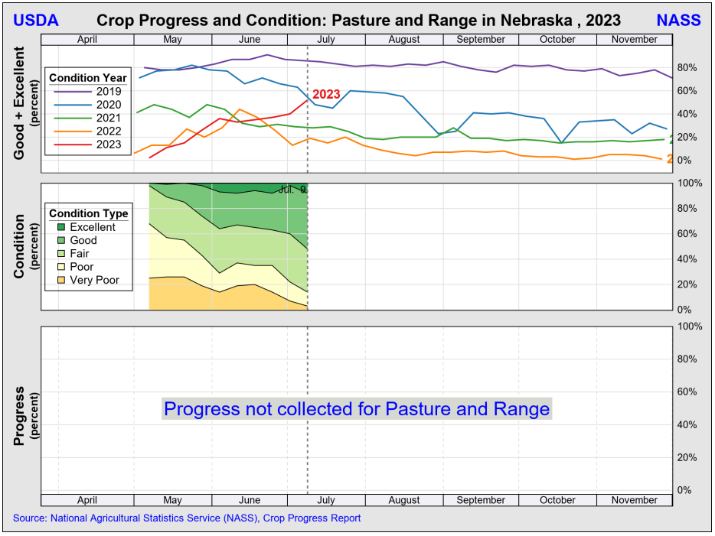
7-10-23

Slide 15
Crop Progress and Condition July 10
 | 7/10/2023 | Last Year | 5-Year Average
Winter Wheat: Harvested | 12% | 34% | 25%
Corn: Silking | 21% | 7% | 15%
Soybeans: Blooming | 43% | 38% | 42%
Soybeans: Setting Pods | 3% | 2% | 5%
7-10-23

Slide 16
Upcoming Reports
Release Date | Title
July 21 | Cattle and Cattle on Feed
August 11 | Crop Production
August 25 | Cash Rent County Estimates
Notes:
August 11 Crop Production will have first survey based yield and production forecast for row crops and hay.

Slide 17
United States Department of Agriculture
National Agricultural Statistics Service
All Reports Available At
www.nass.usda.gov
For Questions
402-437-5541
800-582-6443
Nicholas.Streff@usda.gov

